Slide 1







Anime Reco. Sys.
Presentation on the most important
Points on the project

Slide 2
🥰 Ohayo 🥰

Slide 3




What’s it ?
is a style of animation that originated in Japan and has gained popularity worldwide. It encompasses a wide range of genres, including action, romance, fantasy, and science fiction.

Slide 4



Some problem people face
Sometimes you see new anime, you want to see something similar to the same
Of the anime, Main character, and graphics of anime!
BUT !!
Not all dream can exist…
But with Mining it can happen! Using some tools will solve the problem of 42% of people
“the number is troll heheheh"

Slide 5
Contents of the project
description
Wrangle
extraction
Data’s link and the important info.
Cleaning and
Loading process
Trying to find
Some Patterns from
VIZ
Faced problems
Modelling
Com. results
The problems have been faced
The main models
Used and tools
Achieved the
Needed problem?

Slide 6



description
Source of data
Thanks to myanimelist.net API for providing anime data and user ratings.
Link of data : Anime Recommendations Database | Kaggle
Difference between rating in Anime and rates
The rates in anime is the average value of all rates
Rates in rates data, the user X has rated anime Y
What’s the key to connect the 2 data ?
The connection between Anime and rates is the anime id
Fields and description of this data provided
In README.MD file

Slide 7





Wrangle function
involves processing the data in various formats like - merging, grouping, concatenating etc. for the purpose of analyzing or getting them ready to be used with another set of data
This function has been used to check up all needed requirements of data and cleaning process
And in the last of this function has been merged the 2 data sets together to lead for full data of anime
This data had killed our devices “7 million rows”

Slide 8






FAMOUS ANIMES
01
02
03

Slide 9



Category | Average Rating Range | Users' Rating Range | Most Common Rating
TV | 6-8 | 6-10 | 8
OVA | 5.5-7 | 6-9 | 7
ONA | 4-7.5 | 5-9 | 7
Movie | 4.5-8 | 6-10 | 8
Special | 5.5-7.5 | 5-9 | 7
Music | 3.5-6.5 | 5-10 | 7

Slide 10

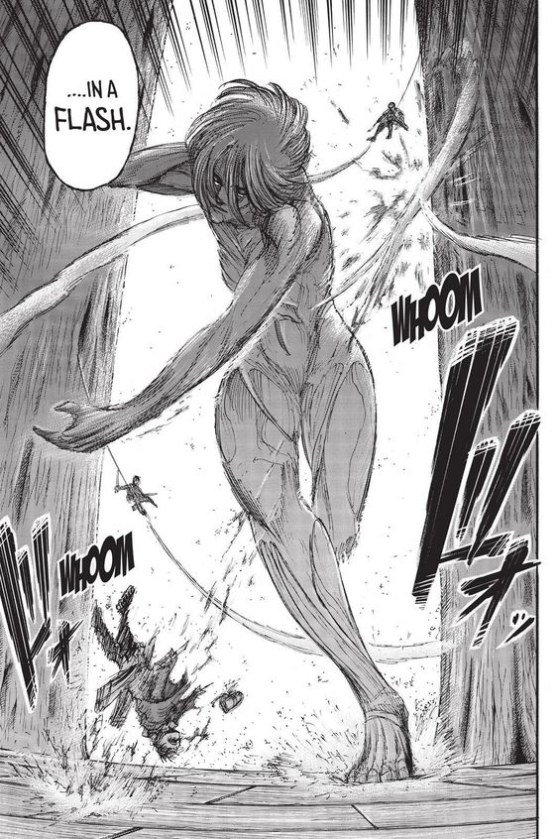
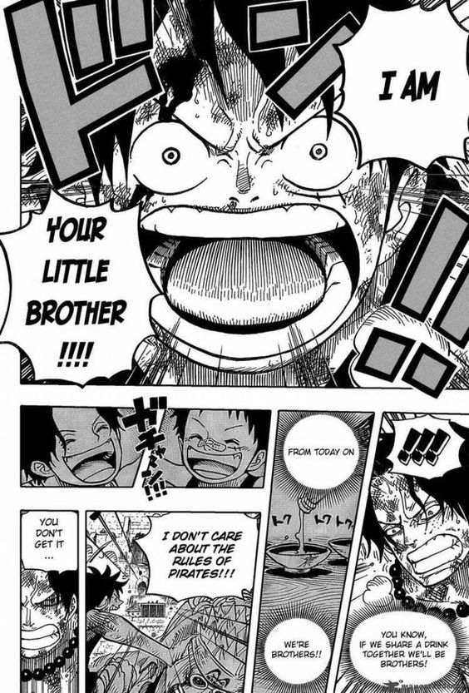
TROUBLES
This data was a reason to face a lot of problems in our Projects
Allocation Size, Why this data need 4.88 gib of c !!
Being unsupervised data was so hard to predict result, only sense of result is good one
Low amount of models, but still could find the appropriate models to perform.

Slide 11
Used Models !!
KNN
SVD
K-MEDOID
It has a lot of types in Clustering operation, but we used UNN, What’s it ?
UNN implements unsupervised nearest neighbors learning based on the naturality of data and returns the needed distances with indices
It’s a factorization matrix, refers to the process of decomposing a given matrix into the product of two or more matrices
It’s like LU matrix which used to calculate unknown parameters numerically and other popular one to calculate, and SVD is one of all these tools
clustering algorithm that is used to partition a dataset into groups or clusters based on similarity measures. It is a variation of the K-Means algorithm, where instead of using the mean value of each cluster, it uses a representative object called a medoid.

Slide 12


Winners of this models !!!
KNN
SVD
K-MEDOID

Slide 13
Winners of this models !!!
KNN
SVD
And result of KNN was So near of the target
anime
And result of SVD was So near of the target
anime
The Mean Squared Error result was equal to 0.0646
The Mean Squared Error result was equal to 0.0696

Slide 14



“ IN THIS WORLD
THERE ARE VERY FEW
PEOPLE WHO ACTUALLY
TRUST EACH OTHER “
- KIRA

Slide 15

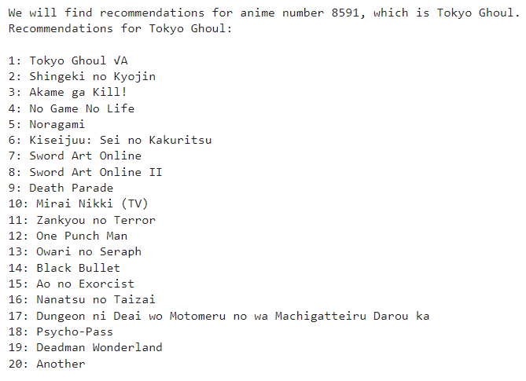

Does result achieved the needed purpose ?
Yes!
Given the result of this project, if you provide the name of an anime, I can suggest 20 similar anime titles for you.
And here’s simple example for you

Slide 16






Team Members
Mahmoud
Abdelrahman
Gowely
Ziad
ALi

Slide 17



THANK YOU

